Slide 1
Module 4: Classification Part 1 TMA4268 Statistical Learning V2023
Daesoo Lee,
Department of Mathematical Sciences, NTNU
30/01/2023

Slide 2
Overview

Slide 3
Overview
Classification and discrimination
Logistic regression
Bayes classifier
KNN

Slide 4
What is classification?

Slide 5
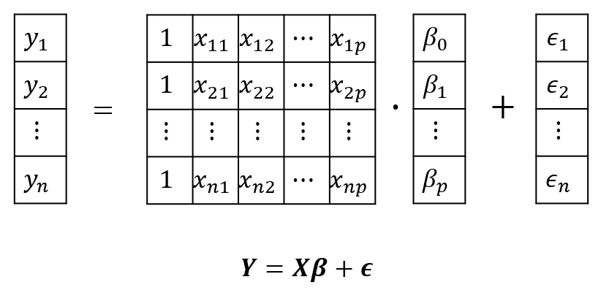
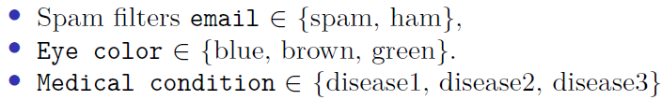
What is classification?
$Y$ is a qualitative variable for regression.
$Y$ can be a quantitative variable $→$ classification!

Slide 6
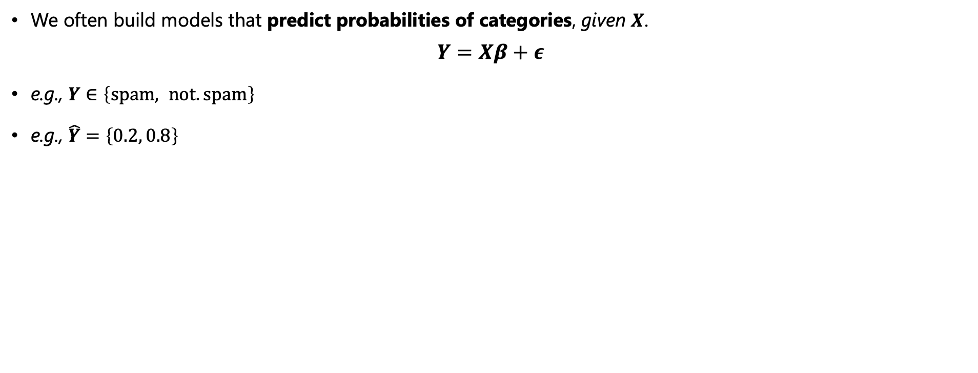
What is classification?
We often build models that predict probabilities of categories, given $X$.
$$Y=Xβ+ε$$
e.g., $Y∈\left\{spam, not.spam\right\}$
e.g., $\hat{Y}=\left\{0.2, 0.8\right\}$

Slide 7
What is classification?
What are the methods?
Three methods for classification are discussed here:
Logistic regression
K-nearest neighbors
Linear and quadratic discriminant analysis (in the next lecture)

Slide 8
Logistic Linear Regression

Slide 9
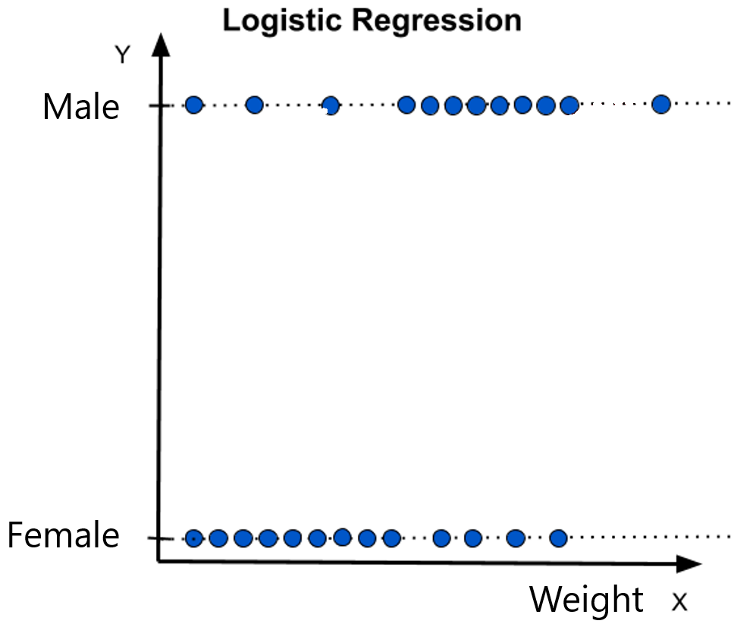
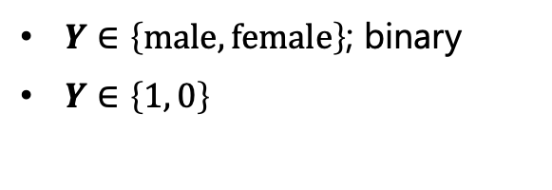
Logistic Linear Regression
Logistic Regression
1.0
Male
$Y∈\left\{male, female\right\}$; binary
$Y∈\left\{1, 0\right\}$
Female
0.0

Slide 10
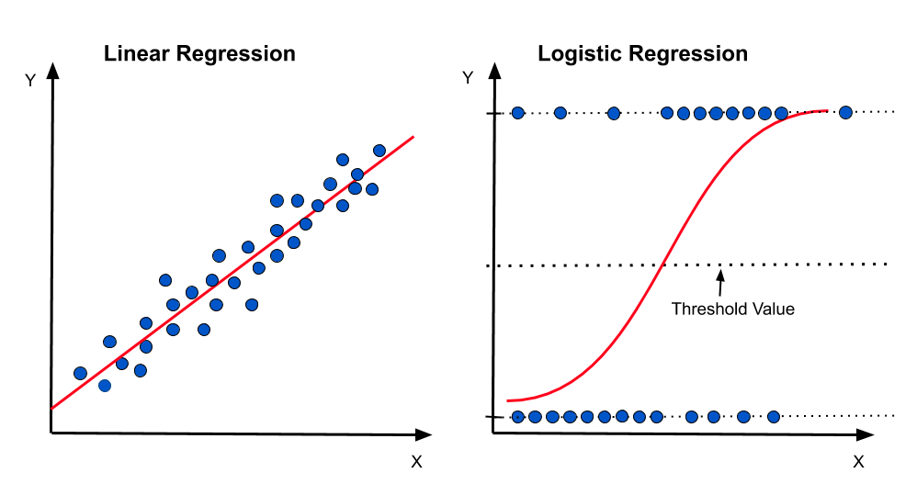

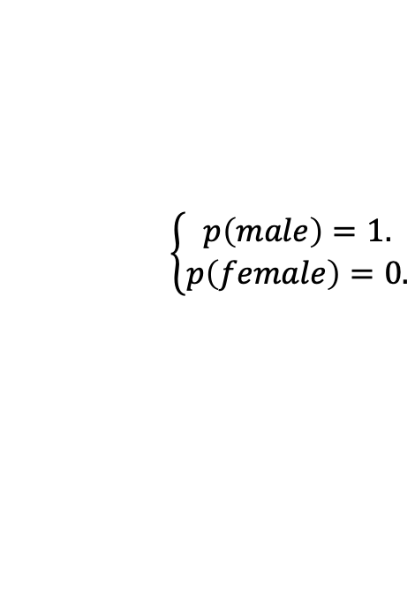
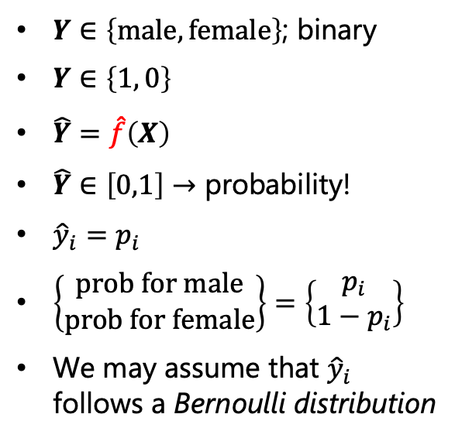
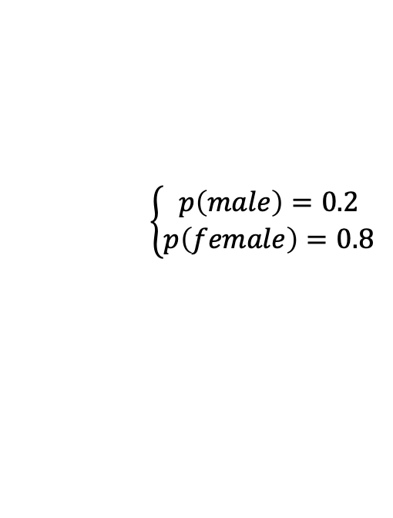
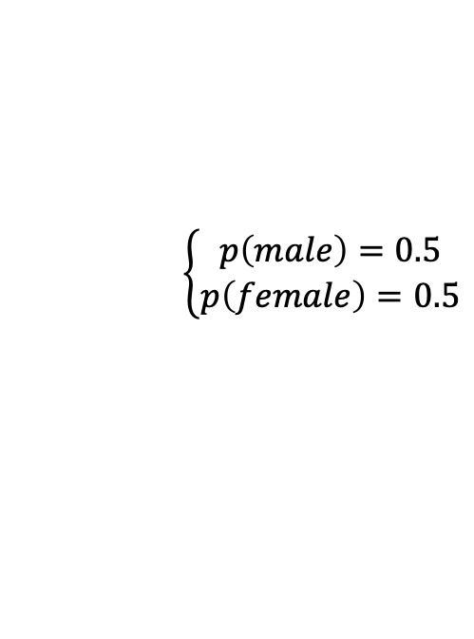

Logistic Linear Regression
Logistic Regression
$$\left\{\begin{aligned}p\left(male\right)=0.5 \\ p\left(female\right)=0.5\end{aligned}\right.$$
$$\left\{\begin{aligned}p\left(male\right)=1. \\ p\left(female\right)=0.\end{aligned}\right.$$
Male
1.0
$Y∈\left\{male, female\right\}$; binary
$Y∈\left\{1, 0\right\}$
$\hat{Y}=\hat{f}\left(X\right)$
$\hat{Y}∈\left[0,1\right]→$ probability!
${\hat{y}}_{i}=p_{i}$
$\left\{\begin{aligned}prob for male \\ prob for female\end{aligned}\right\}=\left\{\begin{aligned}p_{i} \\ 1−p_{i}\end{aligned}\right\}$
We may assume that ${\hat{y}}_{i}$ follows a Bernoulli distribution
Female
0.0
Weight
$$\left\{\begin{aligned}p\left(male\right)=0.2 \\ p\left(female\right)=0.8\end{aligned}\right.$$

Slide 11
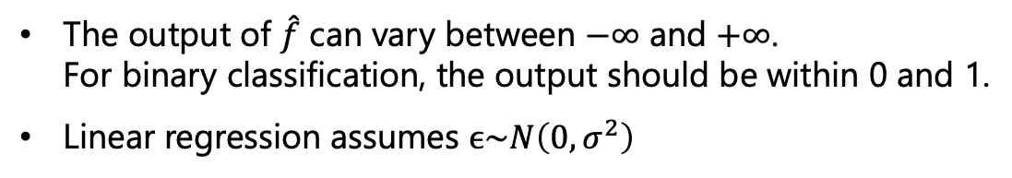
Logistic Linear Regression
Why don’t we just use a linear regression?
1.0
The output of $\hat{f}$ can vary between $−∞$ and $+∞$. For binary classification, the output should be within 0 and 1.
Linear regression assumes $ϵ\sim N\left(0,σ^{2}\right)$
0.0

Slide 12

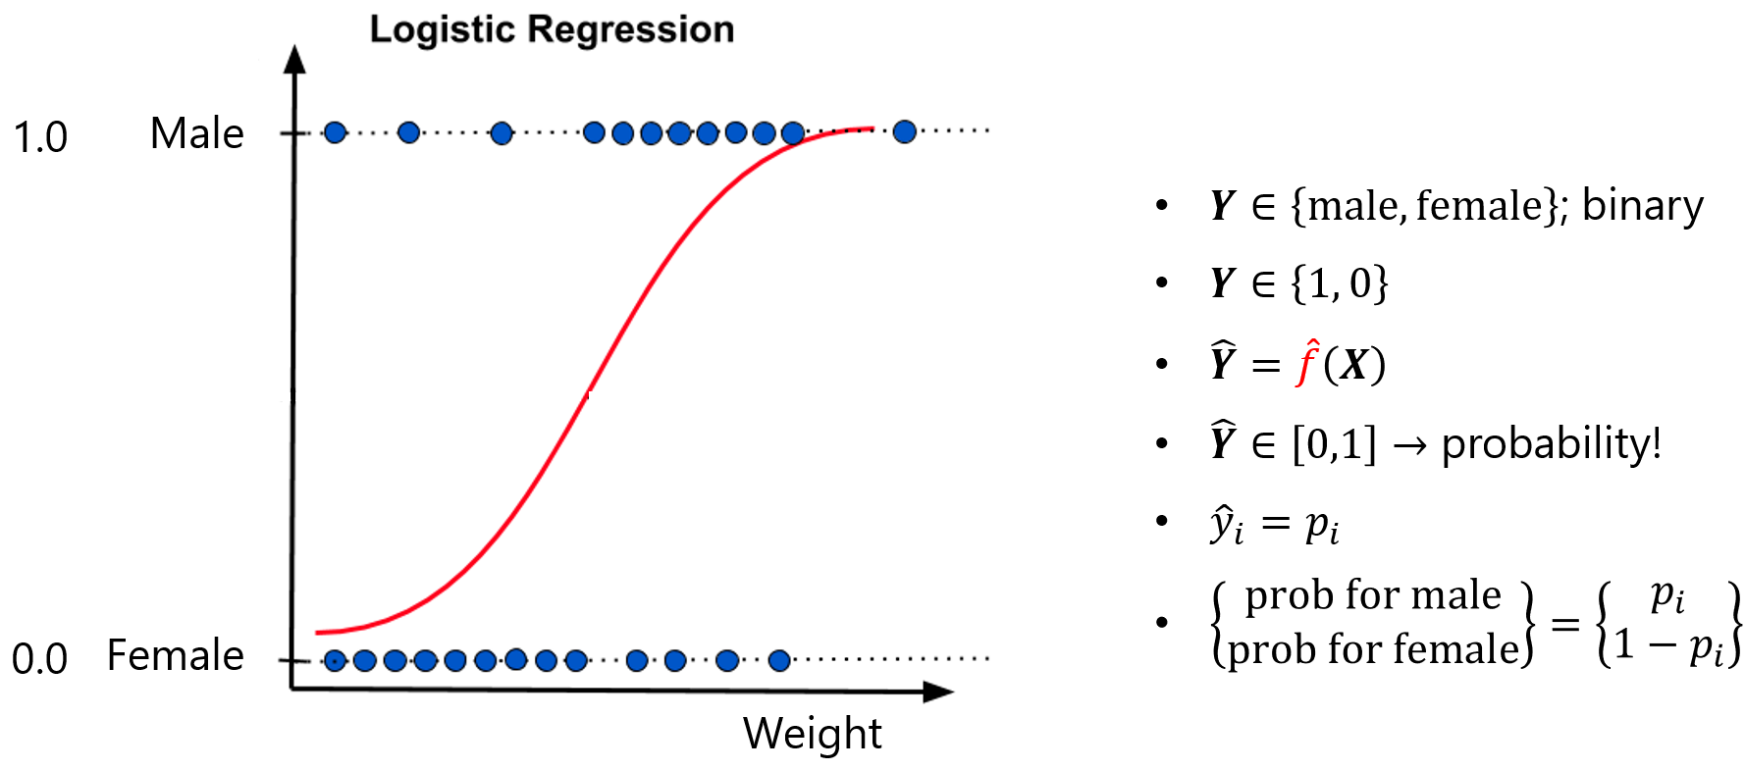
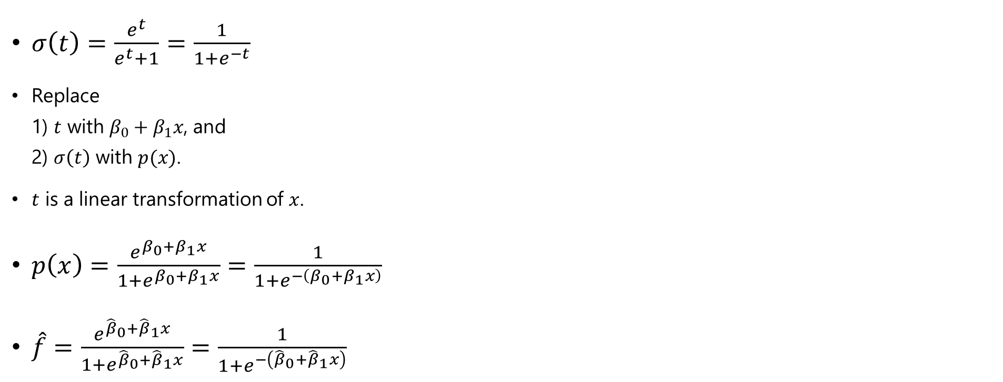
Logistic Linear Regression
How to model $\hat{f}$ ?
Logistic function
=sigmoid function
$σ\left(t\right)=\frac{e^{t}}{e^{t}+1}=\frac{1}{1+e^{−t}}$
Replace 1) $t$ with $β_{0}+β_{1}x$, and 2) $σ\left(t\right)$ with $p(x)$.
$t$ is a linear transformation of $x$.
$p\left(x\right)=\frac{e^{β_{0}+β_{1}x}}{1+e^{β_{0}+β_{1}x}}=\frac{1}{1+e^{−\left(β_{0}+β_{1}x\right)}}$
$\hat{f}=\frac{e^{{\hat{β}}_{0}+{\hat{β}}_{1}x}}{1+e^{{\hat{β}}_{0}+{\hat{β}}_{1}x}}=\frac{1}{1+e^{−\left({\hat{β}}_{0}+{\hat{β}}_{1}x\right)}}$

Slide 13
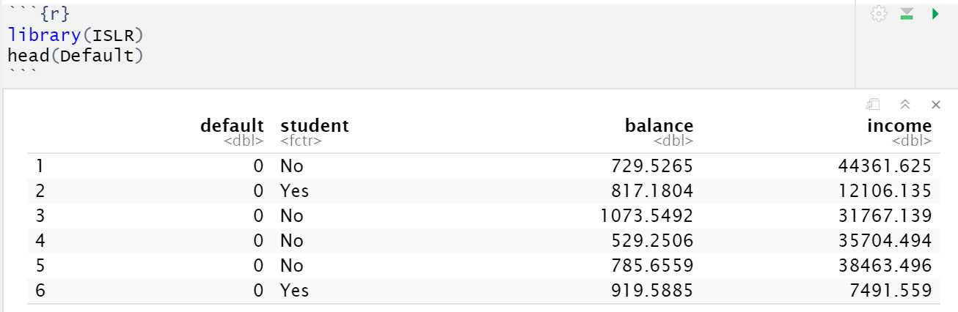


Logistic Linear Regression
Example
We’re now using the Default dataset from the ISLR library

Slide 14
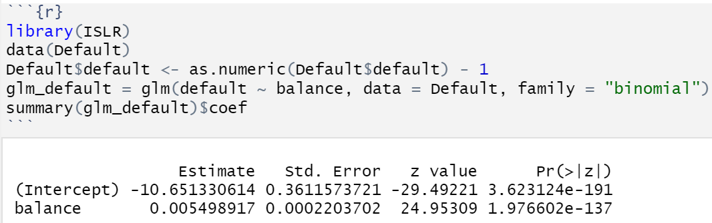
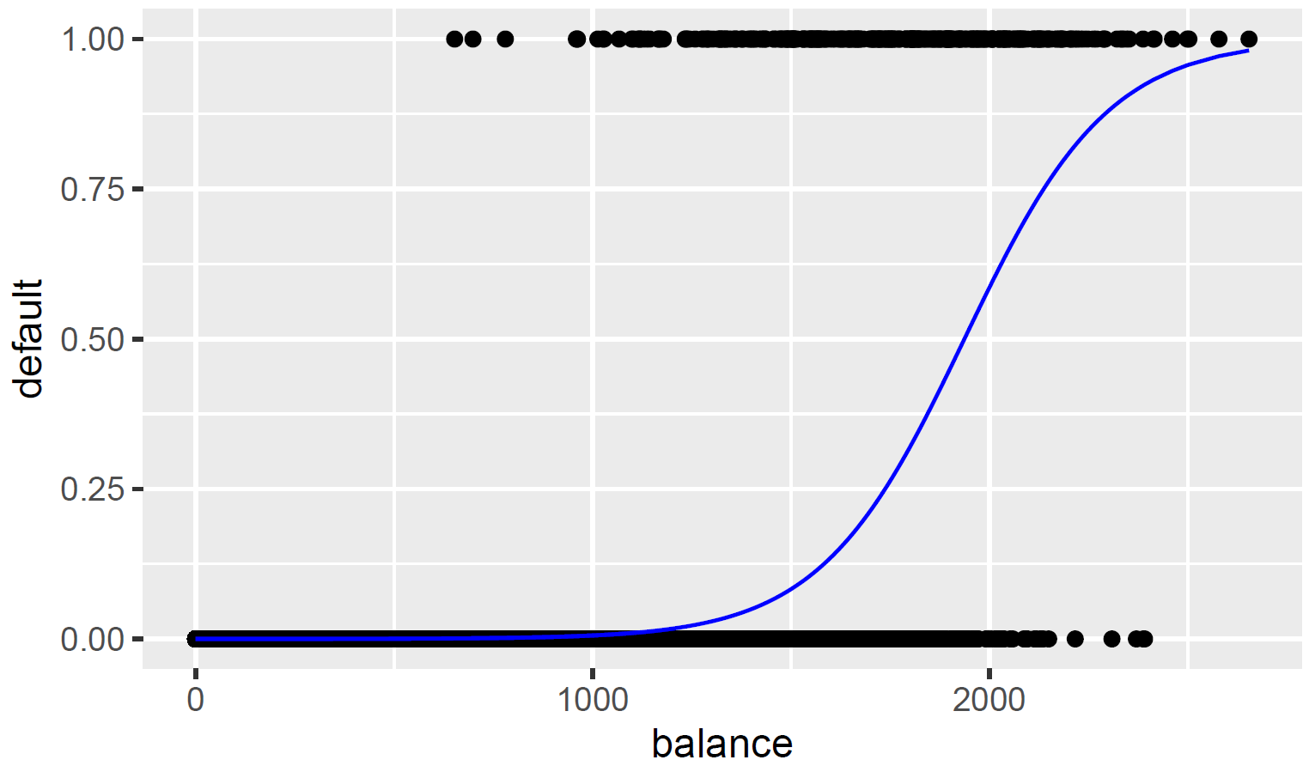
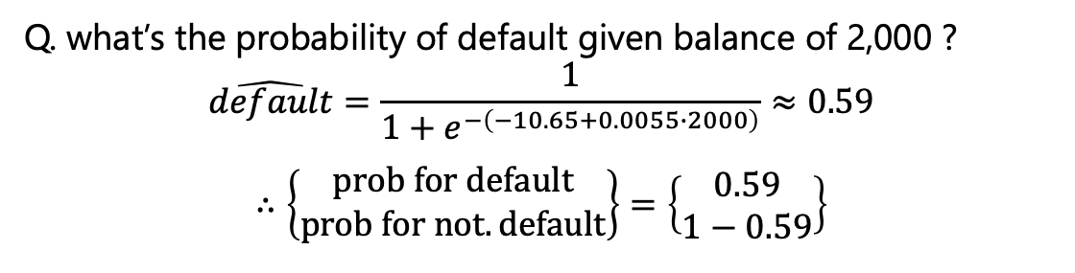
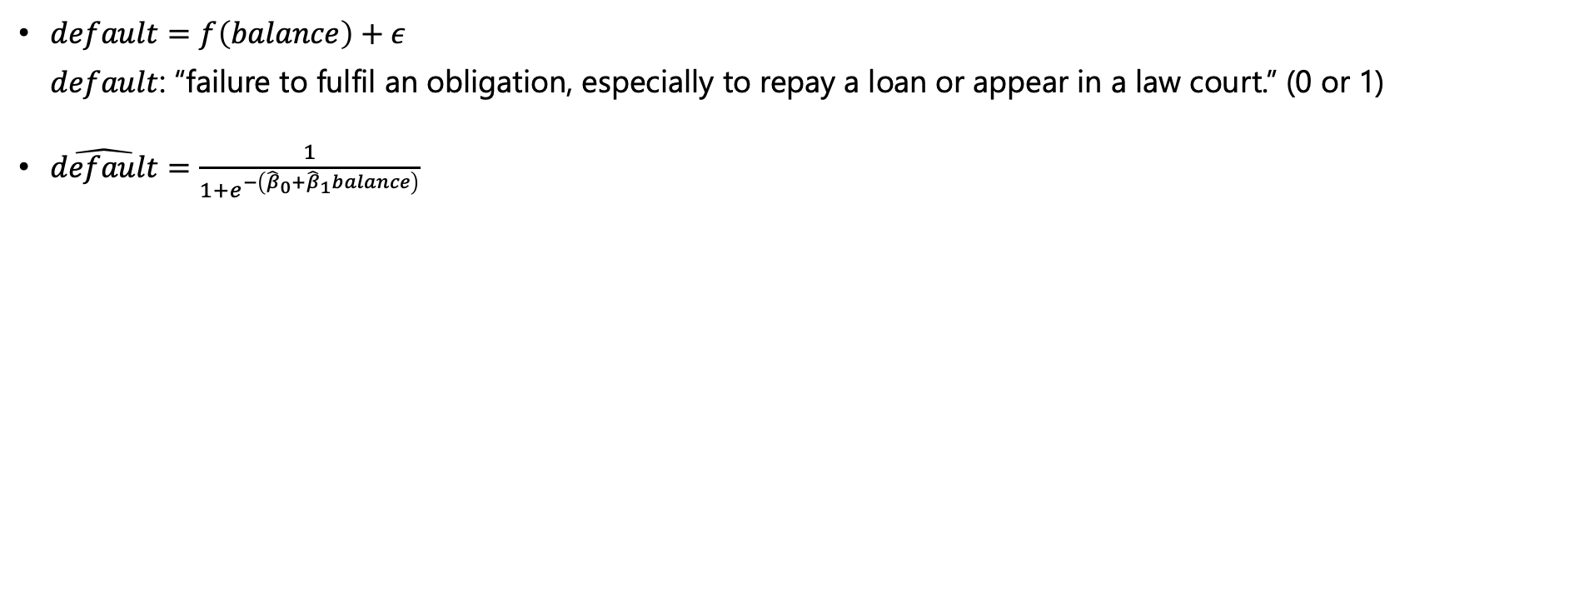

Logistic Linear Regression
Example
$default=f\left(balance\right)+ε$ $default$: “failure to fulfil an obligation, especially to repay a loan or appear in a law court.” (0 or 1)
$\hat{default}=\frac{1}{1+e^{−\left({\hat{β}}_{0}+{\hat{β}}_{1}balance\right)}}$
Q. what’s the probability of default given balance of 2,000 ?
$$\hat{default}=\frac{1}{1+e^{−\left(−10.65+0.0055∙2000\right)}}≈0.59$$
$$∴\left\{\begin{aligned}prob for default \\ prob for not.default\end{aligned}\right\}=\left\{\begin{aligned}0.59 \\ 1−0.59\end{aligned}\right\}$$

Slide 15
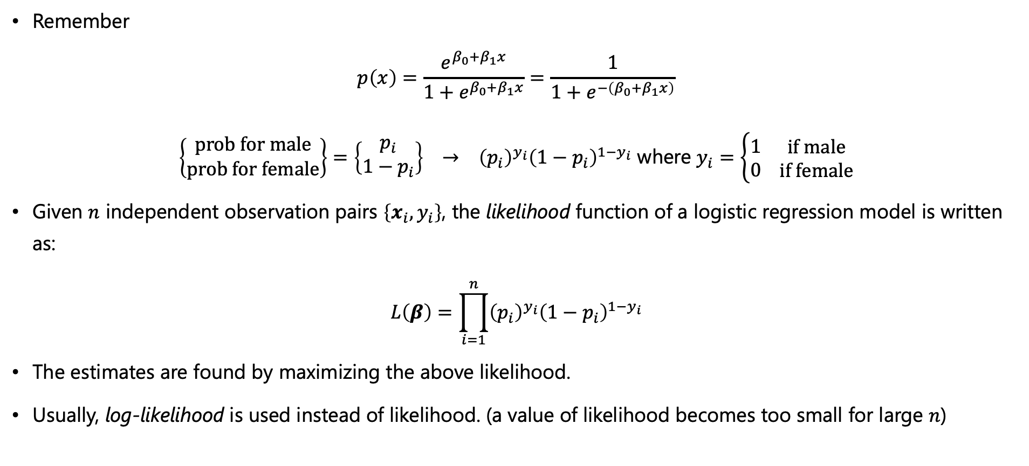
Logistic Linear Regression
Estimating the coefficients
Remember
$$p\left(x\right)=\frac{e^{β_{0}+β_{1}x}}{1+e^{β_{0}+β_{1}x}}=\frac{1}{1+e^{−\left(β_{0}+β_{1}x\right)}}$$
$\left\{\begin{aligned}prob for male \\ prob for female\end{aligned}\right\}=\left\{\begin{aligned}p_{i} \\ 1−p_{i}\end{aligned}\right\} → {\left(p_{i}\right)}^{y_{i}}{\left(1−p_{i}\right)}^{1−y_{i}}$ where $y_{i}=\left\{\begin{aligned}1 \\ 0\end{aligned} \begin{aligned}if male \\ if female\end{aligned}\right.$
Given $n$ independent observation pairs $\left\{x_{i},y_{i}\right\}$, the likelihood function of a logistic regression model is written as:
$$L\left(β\right)=\prod_{i=1}^{n}{{\left(p_{i}\right)}^{y_{i}}{\left(1−p_{i}\right)}^{1−y_{i}}}$$
The estimates are found by maximizing the above likelihood.
Usually, log-likelihood is used instead of likelihood. (a value of likelihood becomes too small for large $n$)

Slide 16
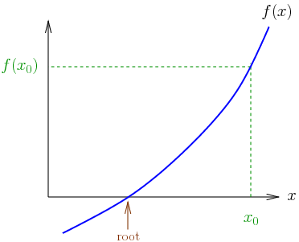
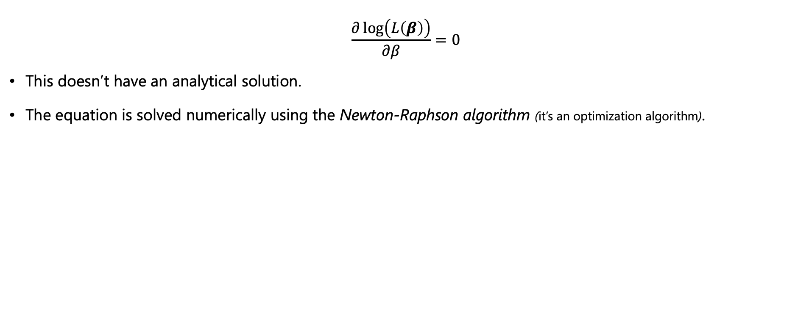

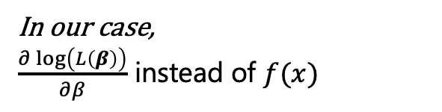
Logistic Linear Regression
Estimating the coefficients
$$\frac{∂\log\left(L\left(β\right)\right)}{∂β}=0$$
This doesn’t have an analytical solution.
The equation is solved numerically using the Newton-Raphson algorithm (it’s an optimization algorithm).
In our case,
$\frac{∂\log\left(L\left(β\right)\right)}{∂β}$ instead of $f(x)$

Slide 17
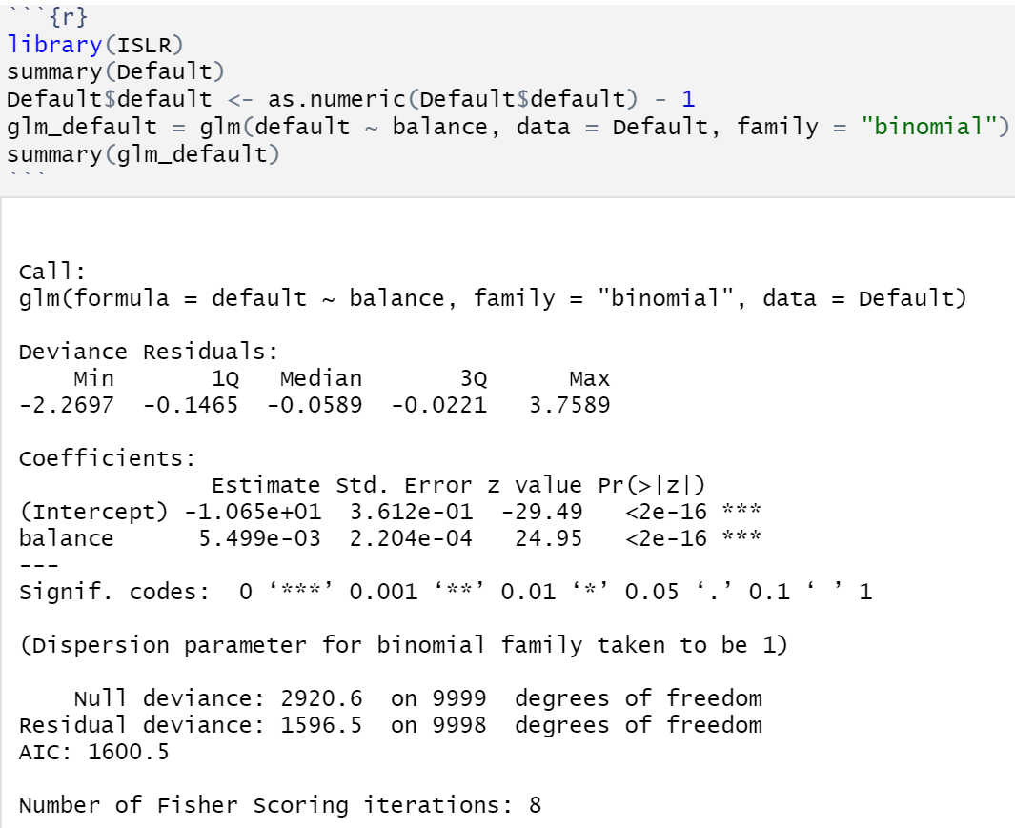
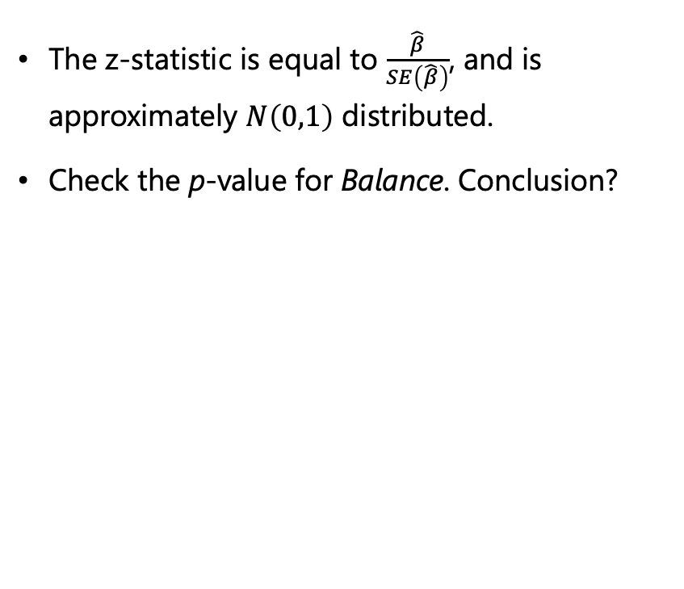
Logistic Linear Regression
Example (continued)
The z-statistic is equal to $\frac{\hat{β}}{SE\left(\hat{β}\right)}$, and is approximately $N\left(0,1\right)$ distributed.
Check the p-value for Balance. Conclusion?

Slide 18
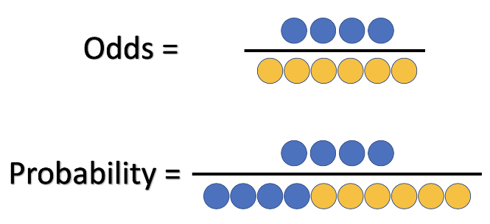
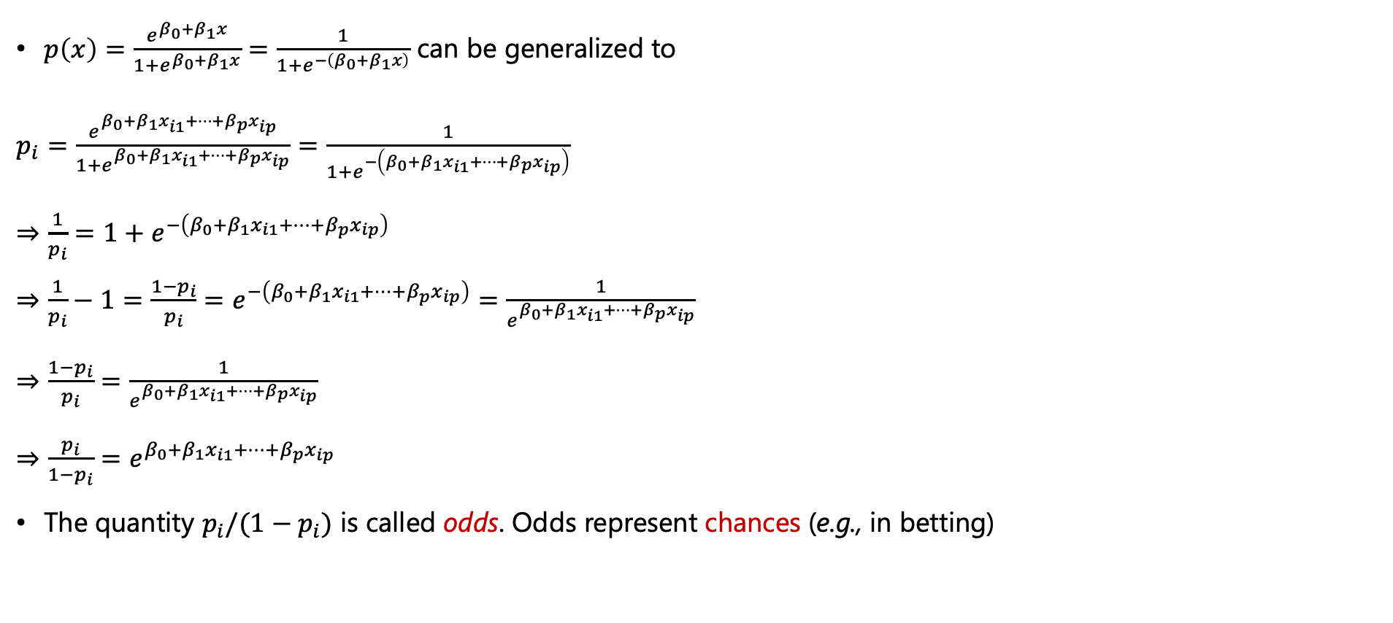
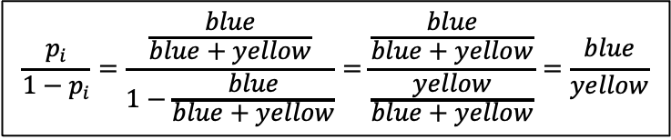
Logistic Linear Regression
Odds
$p\left(x\right)=\frac{e^{β_{0}+β_{1}x}}{1+e^{β_{0}+β_{1}x}}=\frac{1}{1+e^{−\left(β_{0}+β_{1}x\right)}}$ can be generalized to
$p_{i}=\frac{e^{β_{0}+β_{1}x_{i1}+…+β_{p}x_{ip}}}{1+e^{β_{0}+β_{1}x_{i1}+…+β_{p}x_{ip}}}=\frac{1}{1+e^{−\left(β_{0}+β_{1}x_{i1}+…+β_{p}x_{ip}\right)}}$
$⇒\frac{1}{p_{i}}=1+e^{−\left(β_{0}+β_{1}x_{i1}+…+β_{p}x_{ip}\right)}$ $⇒\frac{1}{p_{i}}−1=\frac{1−p_{i}}{p_{i}}=e^{−\left(β_{0}+β_{1}x_{i1}+…+β_{p}x_{ip}\right)}=\frac{1}{e^{β_{0}+β_{1}x_{i1}+…+β_{p}x_{ip}}}$
$⇒\frac{1−p_{i}}{p_{i}}=\frac{1}{e^{β_{0}+β_{1}x_{i1}+…+β_{p}x_{ip}}}$
$⇒\frac{p_{i}}{1−p_{i}}=e^{β_{0}+β_{1}x_{i1}+…+β_{p}x_{ip}}$
The quantity $p_{i}/(1−p_{i})$ is called odds. Odds represent chances (e.g., in betting)
$$\frac{p_{i}}{1−p_{i}}=\frac{\frac{blue}{blue+yellow}}{1−\frac{blue}{blue+yellow}}=\frac{\frac{blue}{blue+yellow}}{\frac{yellow}{blue+yellow}}=\frac{blue}{yellow}$$

Slide 19
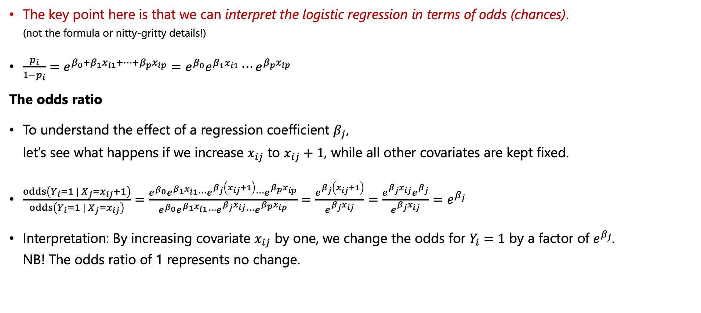
Logistic Linear Regression
What’s the deal with Odds here?
The key point here is that we can interpret the logistic regression in terms of odds (chances). (not the formula or nitty-gritty details!)
$\frac{p_{i}}{1−p_{i}}=e^{β_{0}+β_{1}x_{i1}+…+β_{p}x_{ip}}=e^{β_{0}}e^{β_{1}x_{i1}}⋯e^{β_{p}x_{ip}}$
The odds ratio
To understand the effect of a regression coefficient $β_{j}$, let’s see what happens if we increase $x_{ij}$ to $x_{ij}+1$, while all other covariates are kept fixed.
$\frac{odds\left(Y_{i}=1 | X_{j}=x_{ij}+1\right)}{odds\left(Y_{i}=1 | X_{j}=x_{ij}\right)}=\frac{e^{β_{0}}e^{β_{1}x_{i1}}⋯e^{β_{j}\left(x_{ij}+1\right)}⋯e^{β_{p}x_{ip}}}{e^{β_{0}}e^{β_{1}x_{i1}}⋯e^{β_{j}x_{ij}}⋯e^{β_{p}x_{ip}}}=\frac{e^{β_{j}\left(x_{ij}+1\right)}}{e^{β_{j}x_{ij}}}=\frac{e^{β_{j}x_{ij}}e^{β_{j}}}{e^{β_{j}x_{ij}}}=e^{β_{j}}$
Interpretation: By increasing covariate $x_{ij}$ by one, we change the odds for $Y_{i}=1$ by a factor of $e^{β_{j}}$. NB! The odds ratio of 1 represents no change.

Slide 20
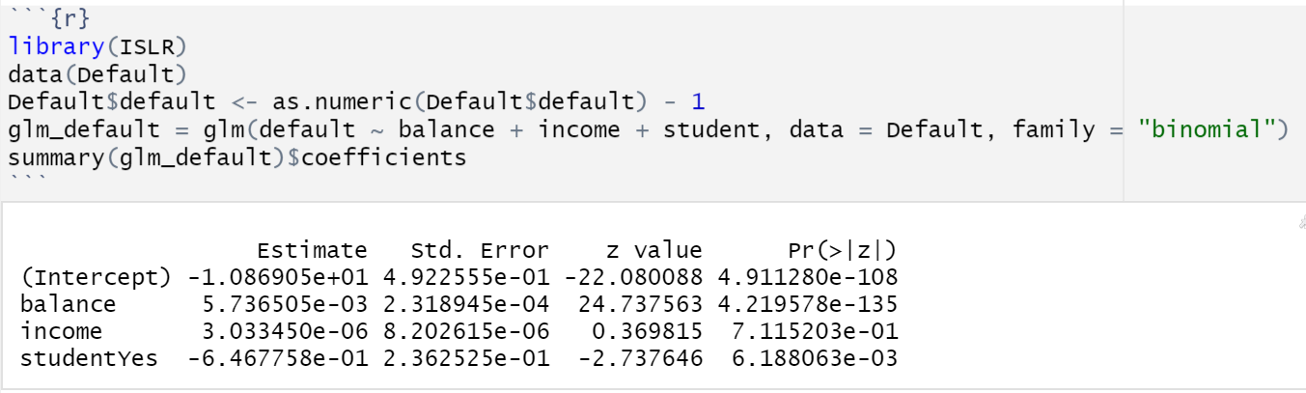
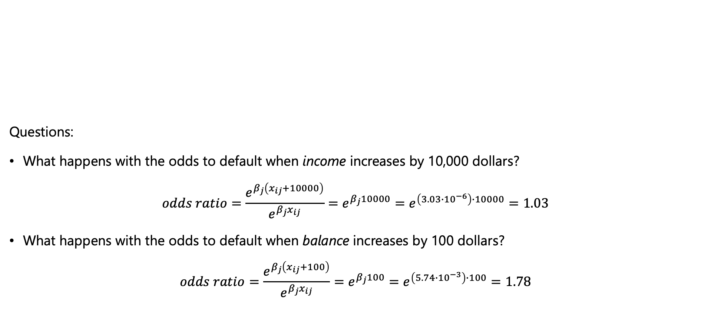
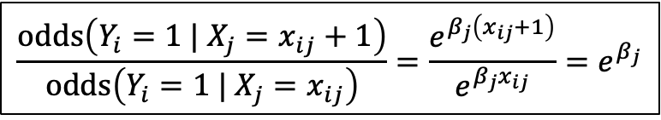
Logistic Linear Regression
$$\frac{odds\left(Y_{i}=1 | X_{j}=x_{ij}+1\right)}{odds\left(Y_{i}=1 | X_{j}=x_{ij}\right)}=\frac{e^{β_{j}\left(x_{ij}+1\right)}}{e^{β_{j}x_{ij}}}=e^{β_{j}}$$
NB! The odds ratio of 1 represents no change.
Example
Questions:
What happens with the odds to default when income increases by 10,000 dollars? $odds ratio=\frac{e^{β_{j}\left(x_{ij}+10000\right)}}{e^{β_{j}x_{ij}}}=e^{β_{j}10000}=e^{\left(3.03∙{10}^{−6}\right)∙10000}=1.03$
What happens with the odds to default when balance increases by 100 dollars? $odds ratio=\frac{e^{β_{j}\left(x_{ij}+100\right)}}{e^{β_{j}x_{ij}}}=e^{β_{j}100}=e^{\left(5.74∙{10}^{−3}\right)∙100}=1.78$

Slide 21
The Bayes classifier

Slide 22
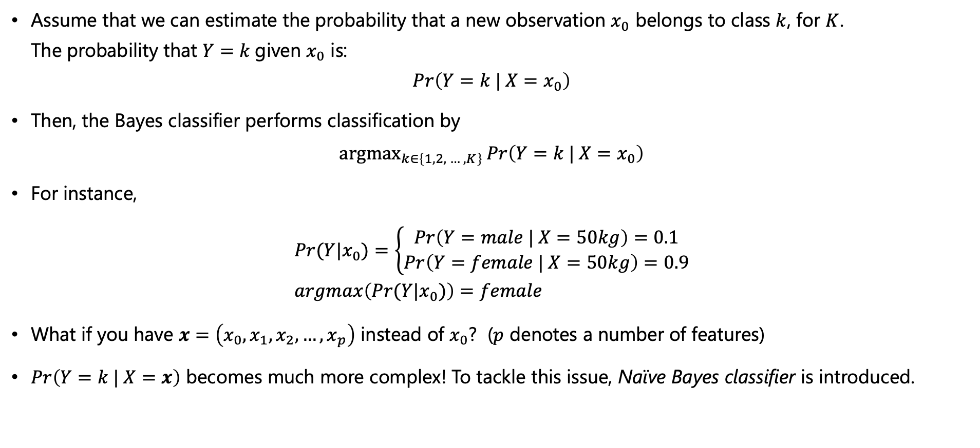
The Bayes classifier
Bayes Classifier
Assume that we can estimate the probability that a new observation $x_{0}$ belongs to class $k$, for $K$. The probability that $Y=k$given $x_{0}$ is:
$$\operatorname{Pr}\left(Y=k | X=x_{0}\right)$$
Then, the Bayes classifier performs classification by
$$argmax_{k∈\left\{1,2, … ,K\right\}}\operatorname{Pr}\left(Y=k | X=x_{0}\right)$$
For instance, $Pr⁡(Y|x_{0})=\left\{\begin{aligned}\operatorname{Pr}\left(Y=male | X=50kg\right)=0.1 \\ \operatorname{Pr}\left(Y=female | X=50kg\right)=0.9\end{aligned}\right.$ $argmax\left(Pr⁡(Y|x_{0})\right)=female$
What if you have $x=\left(x_{0},x_{1},x_{2},…,x_{p}\right)$ instead of $x_{0}$? ($p$ denotes a number of features)
$\operatorname{Pr}\left(Y=k | X=x\right)$ becomes much more complex! To tackle this issue, Naïve Bayes classifier is introduced.

Slide 23
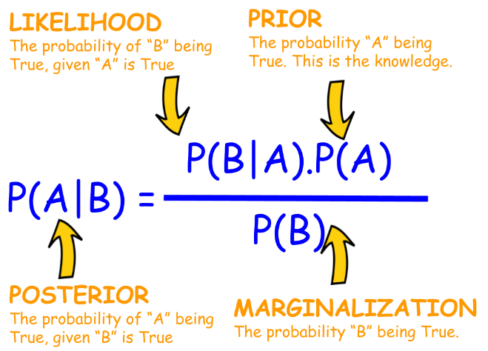
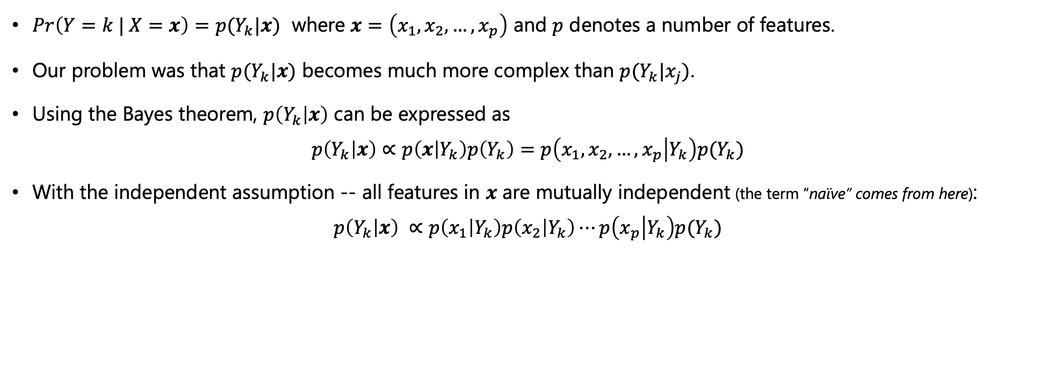
The Bayes classifier
Naïve Bayes Classifier
$\operatorname{Pr}\left(Y=k | X=x\right)=p(Y_{k}|x)$ where $x=\left(x_{1},x_{2},…,x_{p}\right)$ and $p$ denotes a number of features.
Our problem was that $p(Y_{k}|x)$ becomes much more complex than $p(Y_{k}|x_{j})$.
Using the Bayes theorem, $p\left(Y_{k} | x\right)$ can be expressed as $p\left(Y_{k} | x\right)∝p\left(x | Y_{k}\right)p\left(Y_{k}\right)=p\left(x_{1},x_{2},…,x_{p} | Y_{k}\right)p(Y_{k})$
With the independent assumption -- all features in $x$ are mutually independent (the term “naïve” comes from here): $p\left(Y_{k} | x\right) ∝p\left(x_{1} | Y_{k}\right)p\left(x_{2} | Y_{k}\right)⋯p\left(x_{p} | Y_{k}\right)p(Y_{k})$
Bayes Theorem

Slide 24
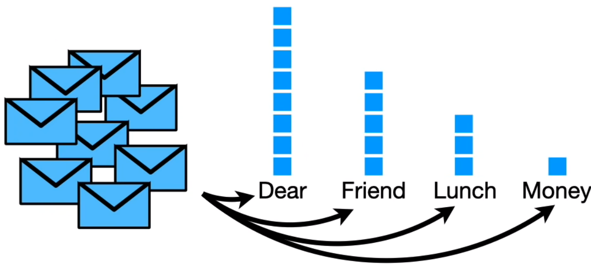
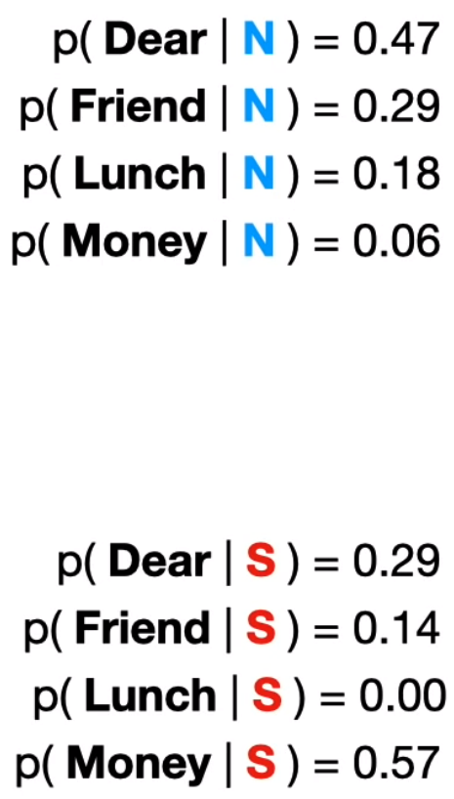
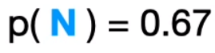
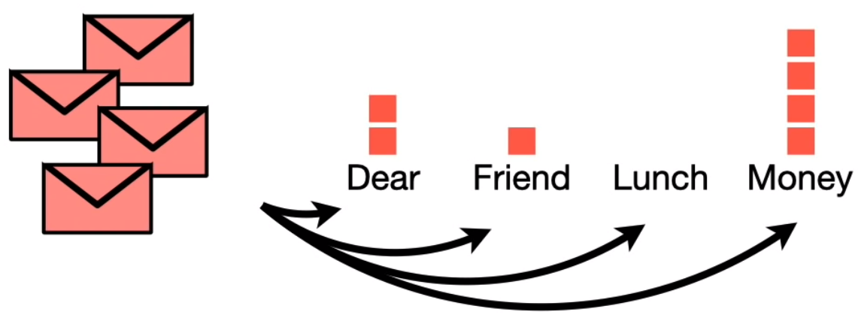
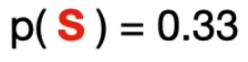
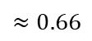
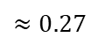
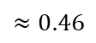
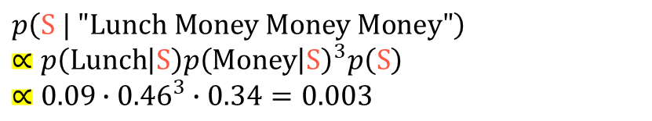
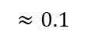
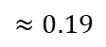
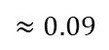
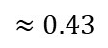
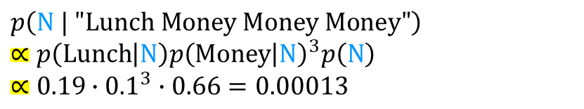
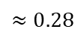
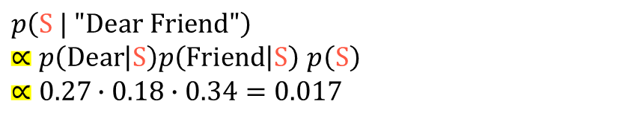



The Bayes classifier
$$p\left(Y_{k} | x\right) ∝p\left(x_{1} | Y_{k}\right)p\left(x_{2} | Y_{k}\right)⋯p\left(x_{p} | Y_{k}\right)p(Y_{k})$$
Example: Naïve Bayes Classifier
Email: “Dear Friend”
9
Normal
$$p\left(N | "Dear Friend"\right) \\ ∝p\left(Dear | N\right)p\left(Friend | N\right)p\left(N\right) \\ ∝0.43∙0.28∙0.66=0.07$$
6
$$≈0.43$$
4
$$≈0.28$$
2
$$≈0.19$$
$$≈0.1$$
$$p\left(S | "Dear Friend"\right)$$ $∝p\left(Dear | S\right)p\left(Friend | S\right)$ $p\left(S\right)$ $$∝0.27∙0.18∙0.34=0.017$$
$$≈0.66$$
5
3
$$≈0.27$$
2
Email: “Lunch Money Money Money”
1
$$≈0.18$$
$$≈0.09$$
$$p\left(N | "Lunch Money Money Money"\right) \\ ∝p\left(Lunch | N\right)p{\left(Money | N\right)}^{3}p\left(N\right) \\ ∝0.19∙{0.1}^{3}∙0.66=0.00013$$
$$≈0.46$$
SPAM
$$≈0.34$$
$$p\left(S | "Lunch Money Money Money"\right) \\ ∝p\left(Lunch | S\right)p{\left(Money | S\right)}^{3}p\left(S\right) \\ ∝0.09∙{0.46}^{3}∙0.34=0.003$$
Total num of emails = 32
https://youtu.be/O2L2Uv9pdDA

Slide 25

The Bayes classifier
Properties of the Bayes classifier
The overall Bayes error rate is given as $1−E\left[\max_{j}{\operatorname{Pr}\left(Y=j | X\right)}\right]$ where the expectation is over $X$.

Slide 26

The Bayes classifier
Training error
Training error rate $\frac{1}{n}\sum_{i=1}^{n}{I\left(y_{i}≠{\hat{y}}_{i}\right)}$ $I$ is an indicator function and is defined as: $I=\left\{\begin{aligned}1 \\ 0\end{aligned} \begin{aligned}if y_{i}≠{\hat{y}}_{i} \\ else\end{aligned}\right.$
The training error rate is the fraction of misclassification made on our training set.

Slide 27

The Bayes classifier
Test error
Test error is the same as the training error except that it is calculated on our test set.
This gives a better indication of the true performance of the classifier than the training error.
We assume that a good classifier is a classifier with a low test error.
Remember this from Module 2!

Slide 28
K-Nearest Neighbor (KNN) classifier

Slide 29


K-Nearest Neighbor (KNN) classifier
KNN classifier estimates $p\left(Y_{k} | x\right)$ non-parametrically.
Classification is done by a majority vote:
$K=3$ $\left\{\begin{aligned}p\left(green | x\right)=2/3 \\ p\left(red | x\right)=1/3\end{aligned}\right.$
$K=7$ $\left\{\begin{aligned}p\left(green | x\right)=3/7 \\ p\left(red | x\right)=4/7\end{aligned}\right.$
$K$: number of neighbors

Slide 30

K-Nearest Neighbor (KNN) classifier

Slide 31


K-Nearest Neighbor (KNN) classifier
How to choose $K$?
$K=1$: the classification is made to the same class as the one nearest neighbor.
$K large:$ the decision boundary tends towards a straight line.
Discussion:
When is the bias large? When is the variance large?
How to find the optimal $K$?
High Bias
Low Variance
Low Bias
High Variance

Slide 32




K-Nearest Neighbor (KNN) classifier
How to find the optimal $K$?
Test error
$$K$$

Slide 33


K-Nearest Neighbor (KNN) classifier
The curse of dimensionality
KNN can be quite good if the number of predictors $p$ is small and the number of observations $n$ is large. We need enough close neighbors to make a good classification.
The effectiveness of the KNN classifier falls quickly when the dimension of the predictor space is high.
Why? Because the nearest neighbors tend to be far away in high dimensional space. KNN is based on “nearest neighbors” and neighbors are going far away.. Not good!

Slide 34
Two Paradigms for Classification

Slide 35


Two Paradigms for Classification
Two approaches to estimate $Pr\left(Y=k | X=x\right)$
Diagnostic Paradigm
Directly estimating $Pr\left(Y=k | X=x\right)$
e.g., Logistic regression, KNN classification
Sampling Paradigm
Indirectly estimating $Pr\left(Y=k | X=x\right)$ by modeling the likelihood $Pr\left(X=x | Y=k\right)$ and the prior $Pr\left(Y=k\right)$. $Pr\left(Y=k | X=x\right)∝Pr\left(X=x | Y=k\right)Pr\left(Y=k\right)$
Bayes Theorem
Remember Naïve Bayes Classifier?
$$p\left(Y_{k} | x\right) ∝p\left(x_{1} | Y_{k}\right)p\left(x_{2} | Y_{k}\right)⋯p\left(x_{p} | Y_{k}\right)p(Y_{k})$$

Slide 36

The End!

